Slide 1


AMERICAN SIGN LANGUAGE (ASL) HAND GESTURE RECOGNITION USING DEEP LEARNING
Presented by Adham Gamal

Slide 2
OVERVIEW
Abstract
Methodology
Introduction
Result
Problem
Conclusion
Objectives

Slide 3
ABSTRACT
This project presents a real-time American Sign Language (ASL) hand gesture recognition system using computer vision and deep learning techniques. The system captures hand gestures via webcam, processes the images by detecting and cropping the hand region, and classifies the gestures using a trained Convolutional Neural Network (CNN). The dataset was custom-built using captured hand images for each ASL letter and augmented to enhance model generalization. The model was trained using TensorFlow and integrated into a real-time prediction pipeline using OpenCV and the cvzone library. The goal is to facilitate communication between the hearing-impaired and the general public through an accessible and efficient gesture recognition tool. The system achieves high accuracy in live classification and provides a foundation for future extensions like full-sentence recognition or deployment on embedded devices.

Slide 4
INTRODUCTION
Sign language is a crucial method of communication for the deaf and hard-of-hearing community. However, many people outside this community do not understand it, which creates a communication barrier. This project aims to develop a real-time hand gesture recognition system using computer vision and deep learning techniques to translate American Sign Language (ASL) gestures into readable text, making communication more accessible and inclusive.

Slide 5
PROBLEM
Communication barriers exist between hearing and non-hearing individuals.
Sign language is not universally understood by the general public.
Existing solutions like human interpreters are not always accessible or affordable.
There is a lack of portable, real-time systems for sign language recognition.
Need for an automated solution that can translate ASL gestures effectively.

Slide 6
OBJECTIVE
Develop a real-time ASL hand gesture recognition system.
Utilize a webcam for capturing hand gestures.
Train a deep learning model to classify gestures accurately.
Enable easier communication for individuals with hearing impairments.
Ensure the system is efficient, user-friendly, and responsive.

Slide 7
METHODOLOGY
Data Collection: Capture hand gesture images using a webcam.
Preprocessing: Resize and preprocess images for consistency.
Model Training: Train a convolutional neural network (CNN) on the collected dataset.
Integration: Implement the trained model into a real-time system.
Real-time Prediction: Detect and classify hand gestures in a live video stream.

Slide 8
RESULT
The hand gesture recognition model achieved promising results in real-time classification. During testing, the model was able to accurately recognize and classify hand gestures captured through a webcam, with the prediction displayed live on the screen. The model's performance was evaluated based on the accuracy of its predictions against a labeled dataset, achieving a high accuracy rate. The hand detection and gesture recognition process was efficient, with minimal latency. The classifier displayed robust performance under varying lighting conditions and hand orientations, demonstrating the effectiveness of the deep learning model in real-world applications. Further tuning and model enhancement could improve accuracy and robustness, particularly for complex or overlapping hand gestures.

Slide 9
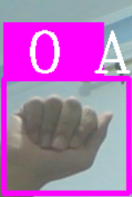
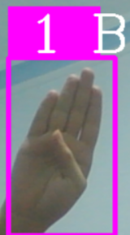
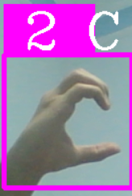
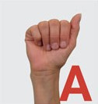
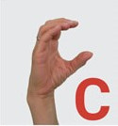
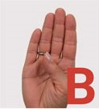

Slide 10
CONCLUSION
The hand gesture recognition system developed successfully classifies gestures in real-time using deep learning models. It performs well in live environments, showing promise for applications in human-computer interaction, assistive technologies, and interactive gaming. While the model’s accuracy is high, further improvements can be made by expanding the dataset and refining the system for better performance under various conditions. This project demonstrates the potential of gesture recognition for diverse real-world applications.

Slide 11
Thank You
For your attention

